Slide 1
Research Terms and Conditions
Research Terms and Conditions
Status Update Briefing to the
Council on Governmental Relations
October 23, 2015

Slide 2
Research Terms & Conditions
NSF & NIH are leading an RBM Interagency Working Group to develop a Research Terms and Conditions Overlay document. The overlay will:
Serve as a companion document to the Uniform Guidance to provide additional clarity for select provisions consistent with government-wide research policy.
Apply to research and research-related grants made by the participating agencies to institutions of higher education and non-profit organizations.

Slide 3
Research Terms & Conditions (Cont’d)
While the Uniform Guidance outlines provisions that are specific to research, the RTC terms and conditions:
Incorporate the entire Uniform Guidance by reference, clarifying or supplementing select provisions where appropriate and consistent with government-wide research policy.
Apply to an award when included as part of the award or when incorporated in the award by reference.

Slide 4
Participating Agencies
Department of Agriculture: NIFA
Department of Commerce: NIST/NOAA
Department of Homeland Security
Department of Energy
Department of Transportation: FAA
Environmental Protection Agency
NASA
NIH – co-Chair
NSF – co-Chair

Slide 5
Timeline to Date
In early 2014, multiple conference calls were held with representatives from the Research Business Models (RBM) Subcommittee to discuss whether, and, if so, how, to proceed with development of a replacement to the now outdated Research Terms and Conditions (RTCs).
RBM approved the Working Group to move forward with development of the proposed implementation model
RBM Working Group delivered clearance package to full RBM on 6/10/2015
SBE Research Subcommittee approved package on August 6, 2015
Package delivered to the Committee on Science (COS) September 15, 2015
COS cleared for publication in Federal Register October 1, 2015
Document published in the Federal Register on October 14, 2015

Slide 6
Documents Included in Implementation Process
The RBM Working Group developed an overlay to the Uniform Guidance which includes or references the following documents:
Prior Approval Matrix (Appendix A)
Subaward Matrix (Appendix B)
National Policy Requirements Matrix (Appendix C)
Implementation Plans
Agency Specific Requirements

Slide 7
Considerations in Development of Draft Documents
National Policy Requirements - The RBM Working Group reviewed the current Matrix and determined that the Policy Matrix will include only Federal-wide Requirements and that each agency would maintain their own agency specific requirements as part of their agency implementation.
Prior Approval Matrix - The RBM Working Group has considered each prior approval requirement identified in the Uniform Guidance using the following criterion:

Slide 8
Decision Process
Do two or more agencies support waiving or changing a requirement?
If yes, the requirement would be waived or changed within the RTC overlay, but agencies would have the discretion to maintain the prior approval within their agency specific requirements.
Example: All financial & performance reports are due within 120 of the end date of the award

Slide 9
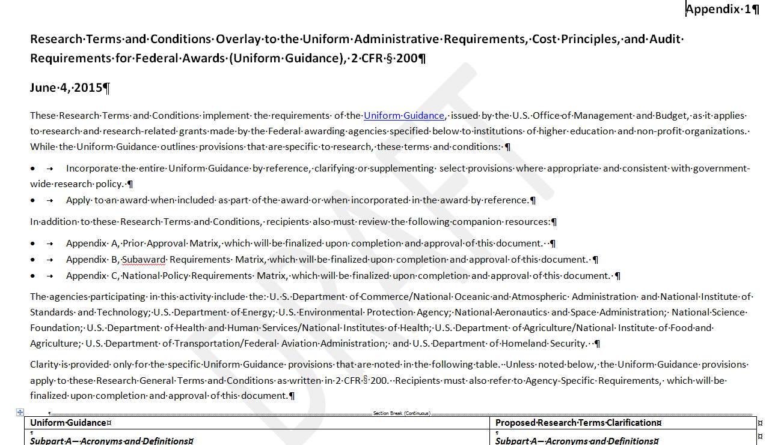
Concept
9

Slide 10
Next Steps
Public & Agency Comments due December 14, 2015
Work with FDP RTC Terms and Conditions Committee to consider development of alternative formats of the RTCs
Re-engage RTC Working Group to consider and resolve comments
Work with OMB/OFFM to consider comments received in the Uniform Guidance comment process
OMB/OFFM has been a strong supporter of this initiative and looks forward to the implementation of the research terms and conditions for agencies to adopt in FY16.
Clear for final implementation using process identified earlier, as well as with OMB/OFFM

Slide 11
Questions
Questions?

