Slide 1
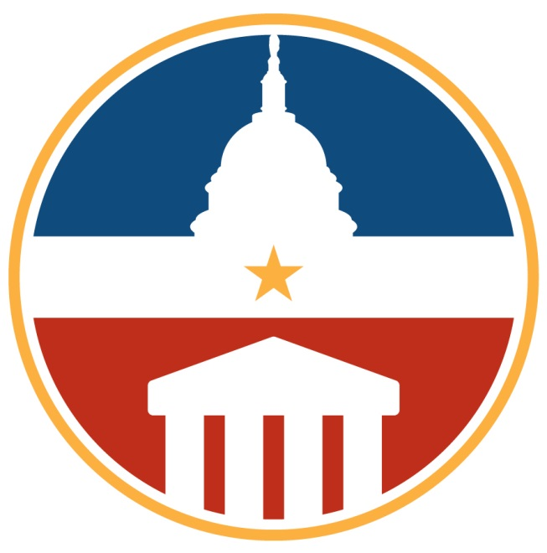
Cindy Hope – Chair 2014-17
Assistant Vice President for Research and Director,
Office for Sponsored Programs, The University of Alabama

Slide 2
WHAT IS THE FDP?
Mission
The Federal Demonstration Partnership (FDP) is an association of federal agencies, academic research institutions… and research policy organizations that work to streamline the administration of federally sponsored research. … The goal of improving the productivity of research without compromising its stewardship has benefits for the entire nation.
The FDP uniquely offers a forum for individuals from universities and nonprofits to work collaboratively with federal agency officials to improve the national research enterprise. At its regular meetings, faculty and administrators talk face-to-face with decision-makers from agencies that sponsor and regulate research. They… test new ways of doing things in the real world before putting them into effect.

Slide 3
HISTORY OF THE FDP
Researchers doing science, not administration
Phase VI: 2014-2020
Phase III - V: 1996-2014
Phase II: 1988 Federal Demonstration Partnership
Phase I: 1986 Florida Demonstration Project
154 institutional recipients of federal funds and 10 Federal Agencies

Slide 4
HISTORY OF SUCCESS
Expanded Authorities
FDP Subaward Agreement
Standard Government-wide Terms and Conditions
Faculty Burden Survey
Emerging Research Institutions GUIRR Partnership Workshop
FDP as key sounding board for Research Business Models Subcommittee of the Committee on Science, grants.gov, research.gov, etc.
ARRA Statistics
FDP Clearinghouse related to FCOI
Congressional Testimony on Administrative Burdens
Payroll Certification

Slide 6
FDP - Phase VI 2014-2020
Researchers doing science, not administration
Update:
Payroll Certification versus Effort Reporting
2 NSF OIG reports issued (George Mason and Michigan Tech)
No findings to indicate Payroll Certification is not a compliant means of documenting salary charges to federal awards
HHS OIG reports
UC Irvine – no audit/opinion
UC Riverside – pending
Expecting a Capstone Report

Slide 7
FDP - Phase VI 2014-2020
Researchers doing science, not administration
Continuing Initiatives Include:
Uniform Guidance Implementation
Procurement workgroup ($3k micro-purchase threshold)
Discussing potential next steps, including a potential demonstration
Research Terms and Conditions Workgroup
Collaborating with COGR
Subrecipient Management -- Expanded Clearinghouse
Notes:
RTCs (8 agencies), DOD T&Cs, etc.

Slide 8
FDP - Phase VI 2014-2020
Researchers doing science, not administration
Current Initiatives Include:
DATA Act
Faculty and Research Compliance Committees
Joint subgroups identifying ways to address faculty burden resulting from policies and procedures that result in the most work and the least value.
Meeting presentations and summaries are available to all on our website.
Notes:
DATA Act – passed May 2014, requires a comprehensive approach to making federal spending data more transparent
• OMB and Treasury are tasked with implementing the legislation
• HHS providing pilot and development support via DATA Act Project Management Office

Slide 9
Cindy Hope – chope@research.ua.edu
David Wright – DWright@nas.edu
thefdp.org

